Slide 1
HPX Workshop (4)
Berkeley C++ Summit 2016

Slide 2
Agenda
How to build HPX
How to build applications using HPX
How to run HPX applications
Architecture of HPX
The API of HPX
Futures, etc.
Async, etc.
Higher level parallel constructs
Execution policies, executors, parameters, targets
Examples
Hello world!
Real world problems
Fibonacci (parallelism for recursive algorithms)
2d stencil (parallelism for iterative algorithms)
Matrix transpose (parallelism for fork-join algorithms)

Slide 3
2D Stencil Example
Parallelism for Iterative Algorithms

Slide 4
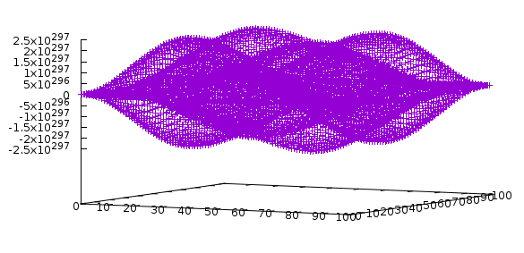
"Solving" a PDE on a 2D Grid
DISCLAIMER: This has no real physics or mathematical background. Left as an exercise for the reader ;)
Running a 5 point stencil on each element:
Boundaries are constant and equal to 1
Update function
new(x,y) = 0.25 * (
old(x-1,y) + old(x+1,y) +
old(x,y-1) + old(x,y+1)
) - old(x,y)

Slide 5
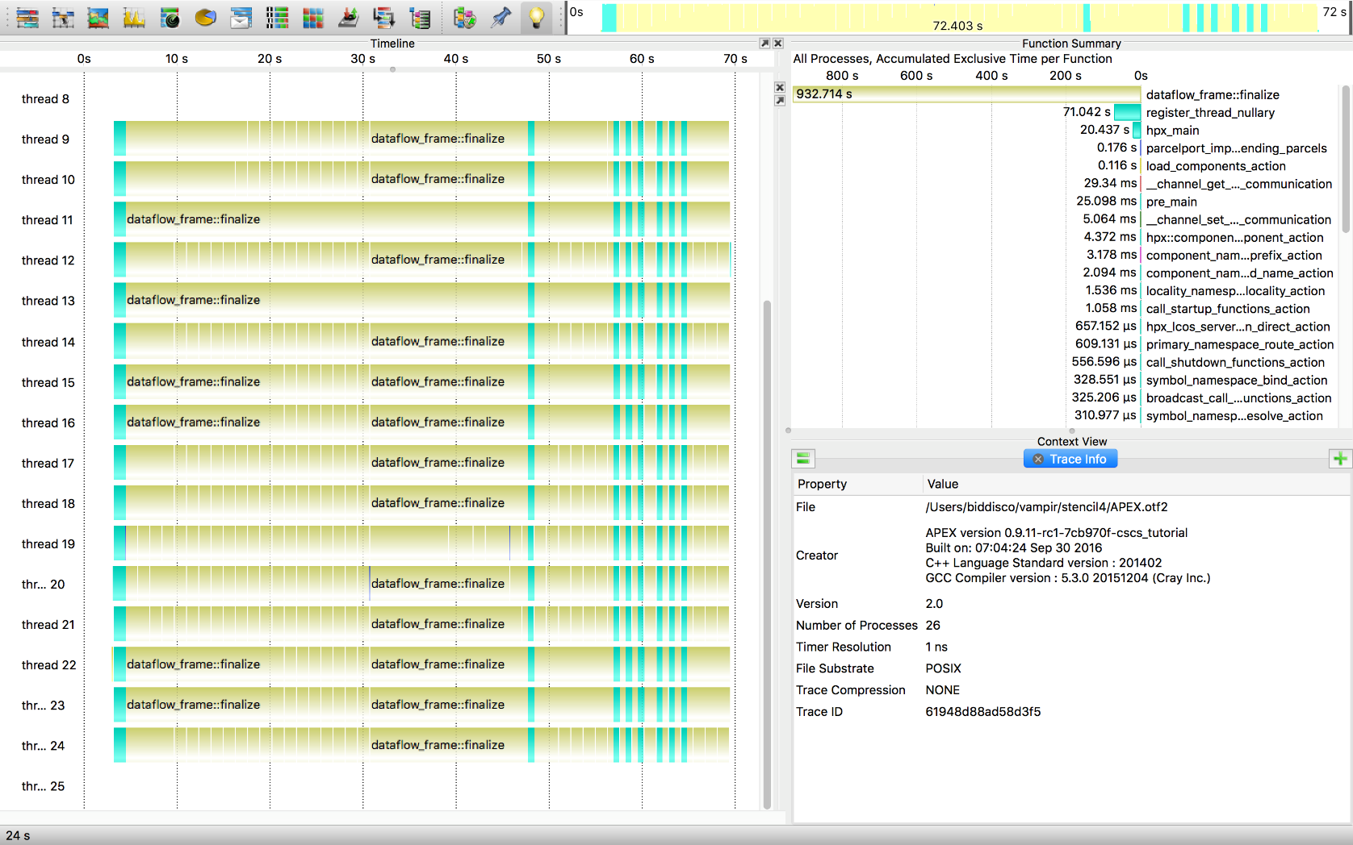
"Solving" a PDE on a 2D Grid
Idle-rate: 2%

Slide 6
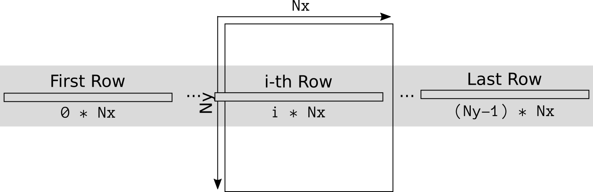
"Solving" a PDE on a 2D Grid
Store 2D grid as a 1D array: std::vector<double>

Slide 7
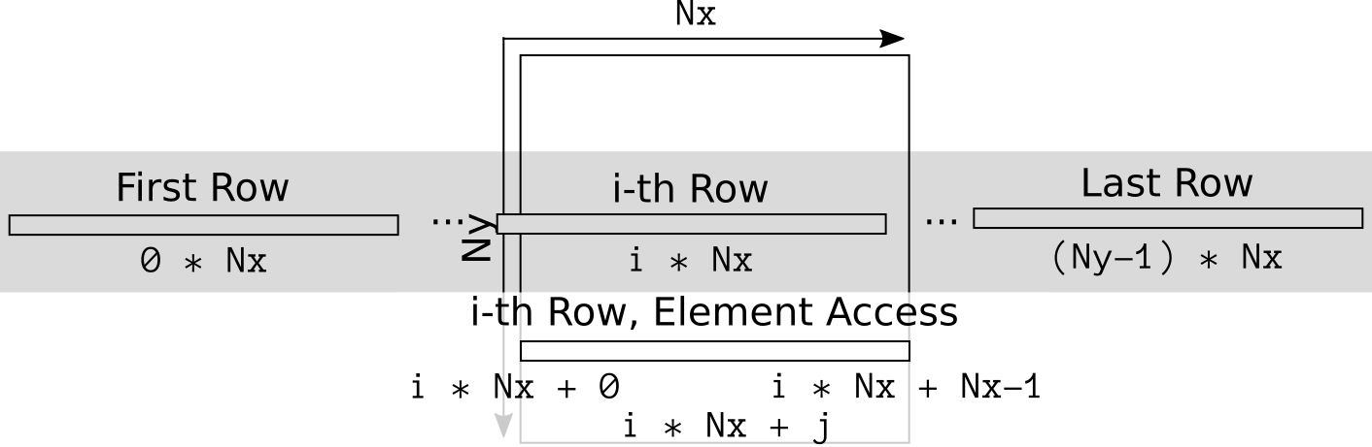
"Solving" a PDE on a 2D Grid
Store 2D grid as a 1D array: std::vector<double>

Slide 8

"Solving" a PDE on a 2D Grid
We want to update line by line
Each line needs its upper and lower neighbor

Slide 9
"Solving" a PDE on a 2D Grid
We want to update line by line, each line needs its upper and lower neighbor
template <typename InIter, typename OutIter>
OutIter line_update(InIter begin, InIter end, OutIter result)
{
++result;
// Iterate over the interior: skip the last and first element
for(InIter it = begin + 1; it != end - 1; ++it, ++result)
*result = 0.25 * (it.up[-1] + it.up[+1] + it.down[-1] + it.down[+1]) *it.middle;
++result;
return result;
}

Slide 10
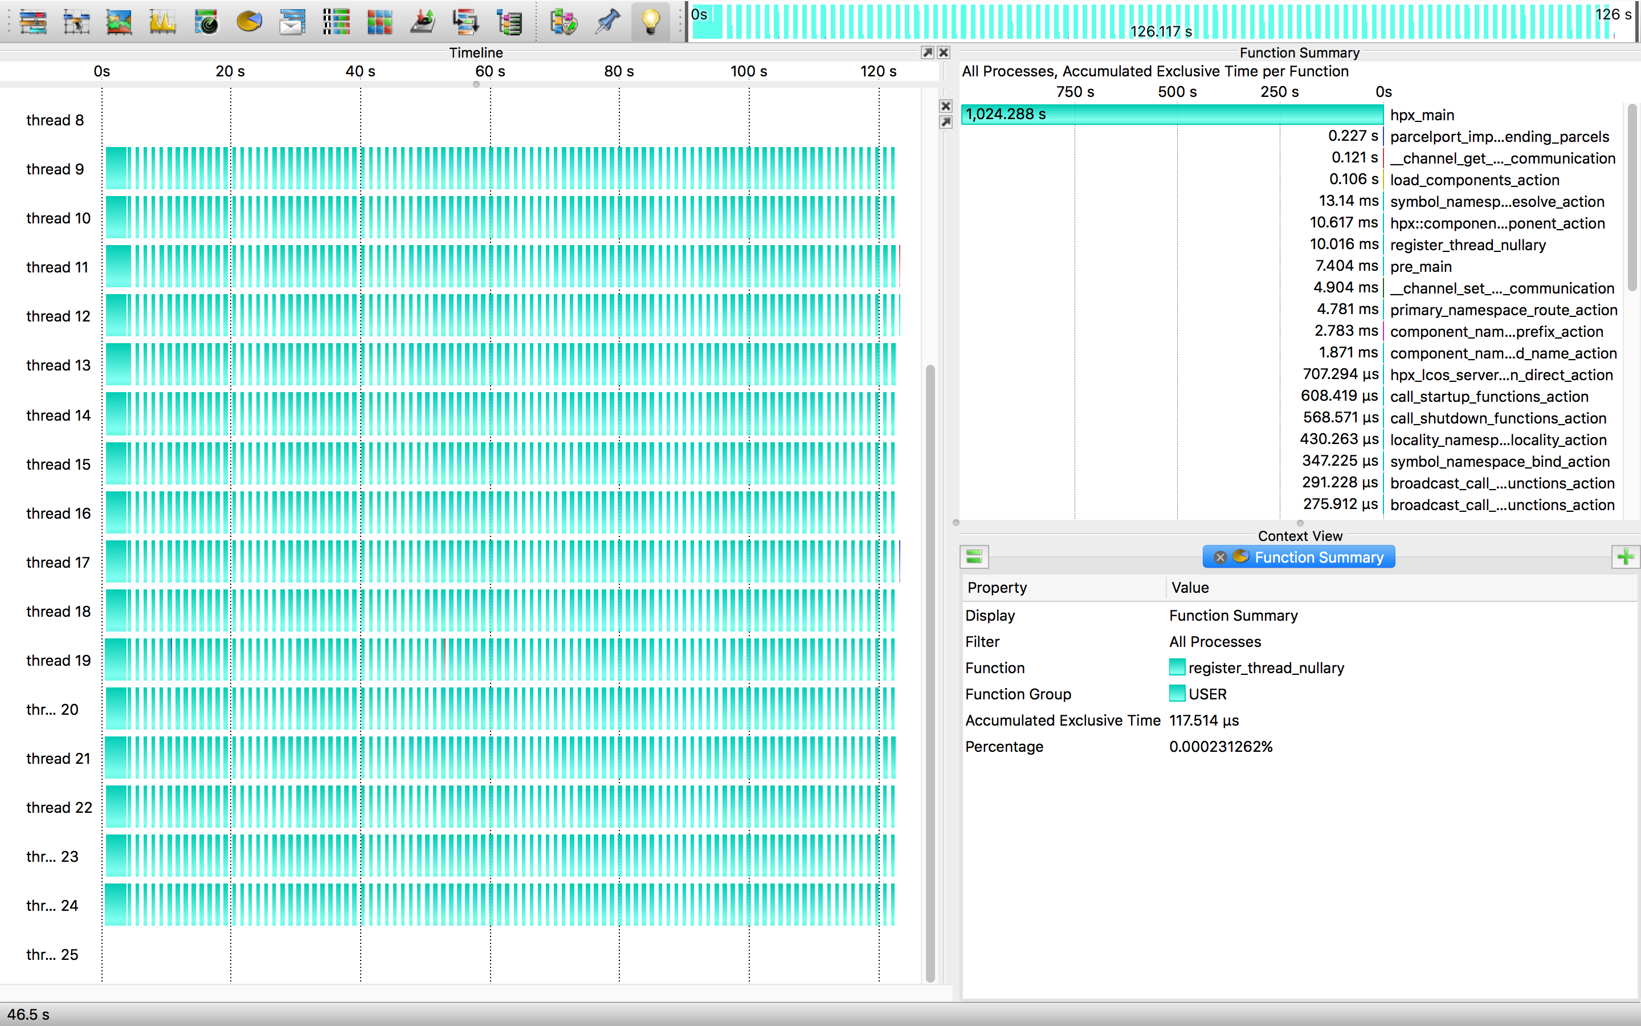
"Solving" a PDE on a 2D Grid
Idle-rate: 48%

Slide 11
Performance Results

Slide 12
